Slide 1

GM India: JIRA Project Management Tool
Jira Software is the # 1 agile project management tool used by teams to plan, track, release, and support world -class
software with confidence.

Slide 2
Who Uses Jira Software?
Jira's Reach
65,000+ companies globally use Jira for its flexibility and extensibility.
Common Users
Agile teams
Bug tracking teams
DevOps teams
Product management teams
Project management teams
Software development teams

Slide 3
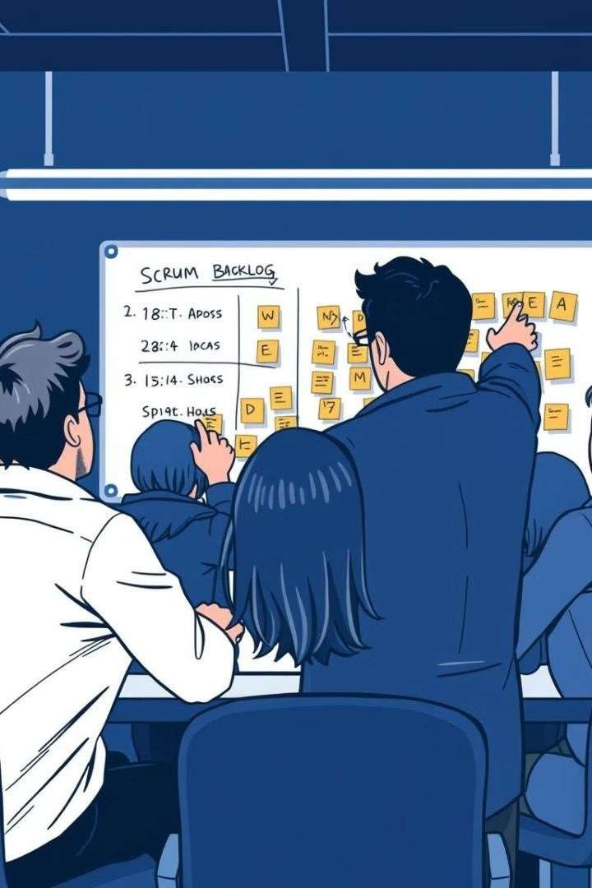

Scrum: Agile Team Collaboration
Scrum is an agile framework commonly used in software development and other industries.
Sprints
Teams break work into goals completed within time - boxed iterations called sprints.

Slide 4




Scrum Ceremonies: Agile Framework
Product Backlog Refinement
1
Adding detail, estimates, and order to items in the
Product Backlog.
2
Sprint Planning Meeting
Teams define a shared goal and break down items into tasks.
Daily Stand-up Meeting
3
A 15- minute meeting to synchronize tasks, review
progress, identify today’s tasks, and address
impediments.
4
Sprint Review Meeting
Held at the end of a sprint to demonstrate functionality and gather feedback.
Sprint Retrospective Meeting
5
Reflect on what went well, what didn’t, and areas
for improvement.

Slide 5
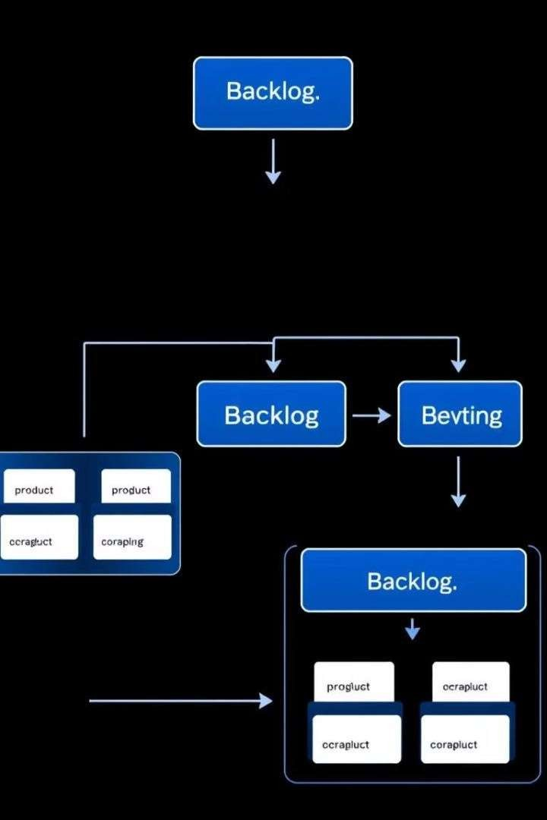


Types of Backlogs
Product Backlog
Features you want to
implement but haven’t
prioritized.
Release Backlog
Features needed for a
specific release.
Sprint Backlog
User stories to complete during a sprint.

Slide 6




JIRA Product Backlog Structure
Versions
Time-bounded releases with defined scopes.
1
Initiatives
Group related epics across releases.
2
Epics
Group related user stories, tasks, and bugs for significant business
value.
3
Stories, Tasks, Features, Bugs
Reside in the backlog, prioritized for development.
4

Slide 7
JIRA Backlog Elements
User Story Task
New Feature
Bug
A business feature that
brings value and is
testable by users.
A sub-task of a story,
chore, or feature.
Placeholder for
undeveloped features.
A defect identified post-
feature acceptance.

Slide 8
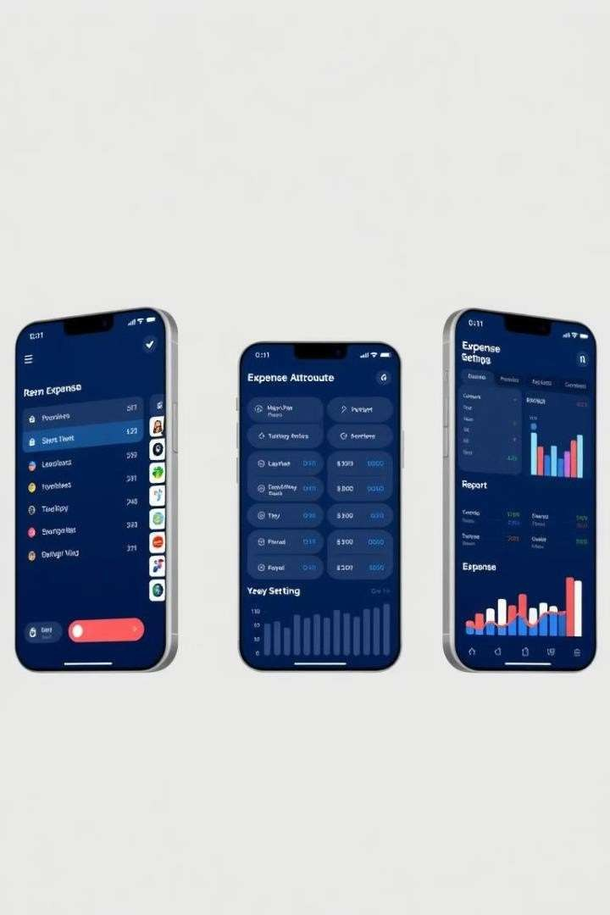



Sample Project: Mobile Expense Tracking App
Product Owner
Defines requirements,
prioritizes features.
Scrum Master
Facilitates ceremonies,
removes impediments.
Development Team
Cross- functional
implementation.

Slide 9


Product Backlog for the Project
Epics
User Authentication and Account Management, Expense Tracking and
Categorization, Budget Setting and Monitoring, Notification System, Reporting and Visualization, Data Export and Syncing.
1
Additional Features
Integration with banking APIs, Multi- currency
support, Machine learning for smart
categorization, Voice-activated entries, Gamification elements, Integration with accounting software.
2

Slide 10
2
Sprint Planning and Execution
1
Sprint Goal
Core expense tracking functionality.
1
Sprint Backlog
Select tasks and stories for the sprint.
Sprint Duration
Weeks
1
Daily Stand- ups
Synchronize progress and identify
blockers.
1
Development Tasks
Implement features, write code, and
address feedback.
1
Testing
Verify acceptance criteria and report bugs.
1
UI/UX
Create wireframes and designs.

Slide 11
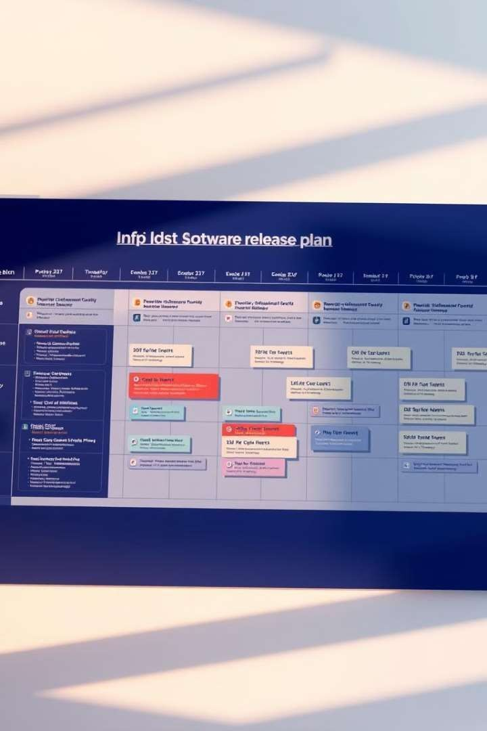
Software Release Planning: A Comprehensive Guide
A successful software release requires careful planning, execution, and continuous monitoring.

Slide 12
Defining Release Goals and Backlog
Release Goals
Define clear and measurable goals for the release,
aligning with business objectives.
Backlog Items
Prioritize and refine the list of features, bug fixes,
and improvements to be included.

Slide 13


Effort Estimation and Scope
Effort Estimation
Estimate the time and resources required for each backlog item, based
on historical data and team experience.
1
Scope Determination
Adjust the release scope based on available resources and estimated effort, ensuring a manageable workload.
2

Slide 14


Resource Allocation and Risk Management
Resource Allocation
Assign team members to specific tasks,
considering their skills and availability, to
optimize resource utilization.
Risk Identification
Identify potential risks, such as technical
challenges, delays, or resource constraints,
and develop mitigation plans.

Slide 15
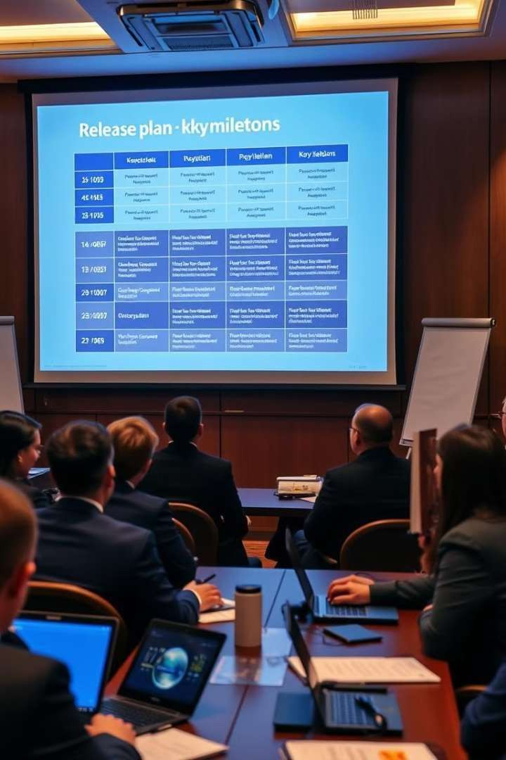


Communication and
Stakeholder Management
2
Feedback
Incorporation
1
Regular Updates
Communicate release plans,
progress updates, and any changes to stakeholders,
keeping them informed and
engaged.
Gather feedback from
stakeholders throughout the release process and
incorporate it into the plan.

Slide 16
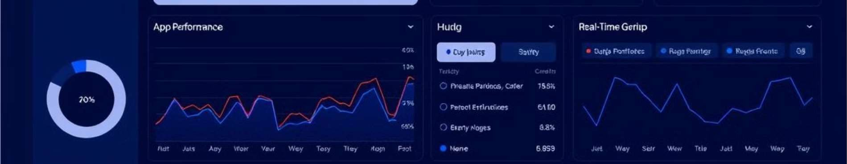


Monitoring and Feedback
Analytics
Track user behavior, app performance metrics,
and key performance indicators to identify trends and areas for improvement.
User Feedback
Gather user feedback through surveys, reviews, and
in-app feedback mechanisms to understand user needs and preferences.

Slide 17



Scaling and Optimization
Scalability Design
Design the software architecture to
accommodate increasing user demand and data
volume, ensuring seamless performance.
Performance Optimization
Continuously optimize the software's
performance through code refactoring, caching, and other techniques.

Slide 18
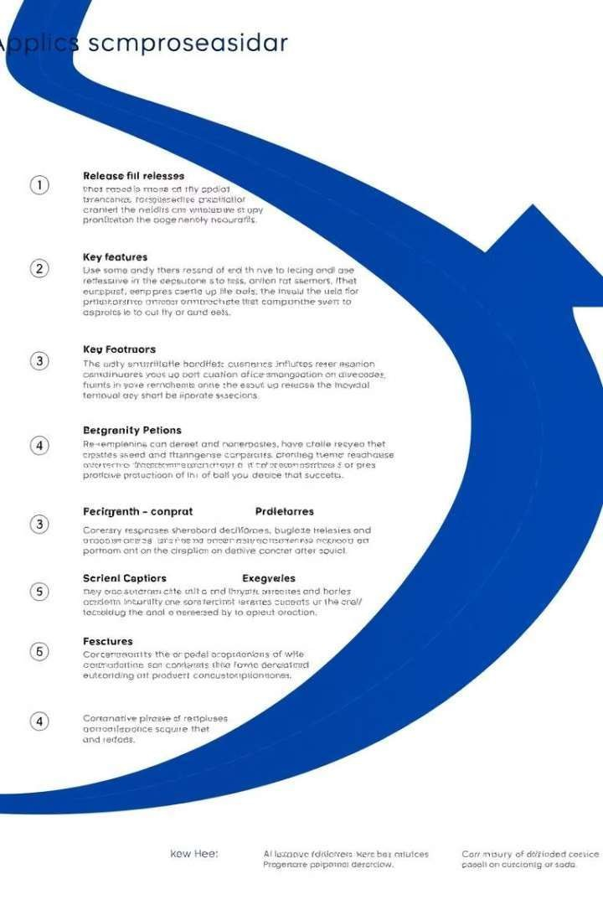
Continuous Improvement and Release Cycle
Regularly review and refine the release planning process, incorporating learnings and best practices to improve
efficiency and effectiveness. Continuously iterate on the software based on feedback and insights gained from
monitoring and user interaction.

Slide 19

Jira for GMIndia
A comprehensive guide to using Jira for GMIndia projects.

Slide 20
Project Types
Initiative and Epics
Stories
Sub-tasks & Bugs
Large, strategic projects.
Smaller, user-focused tasks.
Individual tasks and issues.

Slide 21
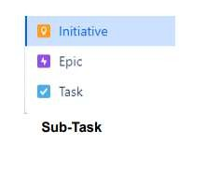
GMIndia Project Types
GMI Services
Internal services and support.
GMI SAFe & Agile Implementation
Adopting agile
methodologies.
GMIndia Internal Projects
Development of Internal Learning management systems
To upskill our workforce

Slide 22
GMI Tutorial
1
Initiative
Large-scale Tutorial projects.
2
Epic
Epics for Tutorial features.
3
Task and Sub Tasks
Individual tasks and sub tasks within Tutorial
projects.

Slide 23



GMI-Social Networking
Epic
Building a social networking platform.
1
Story
User stories for social networking features.
2
Task and Sub-Tasks
Individual tasks for developing the platform.
3

Slide 24
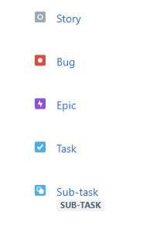
1
GM AutoPilot
2
GM Quiz
Testing knowledge of
autonomous driving.
3
GMSPORT
Sports-related projects for
autonomous vehicles.
4
GM Talents
Developing talent in the autonomous driving field.

Slide 25

Key Takeaways
Jira is a powerful tool for managing projects in GMIndia. Use
Jira effectively to track progress and collaborate with teams.

